Slide 1


CS461
THE SKETCH
MEDICATION MANAGEMENT SYSTEM
Group 2

Slide 2





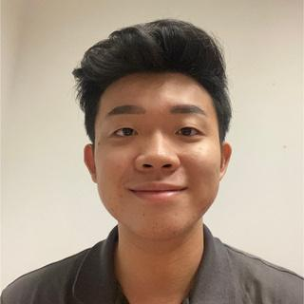
TEAM
Rayner
Franky
Jared
Wei Jie
Chee Sen
ZheTao

Slide 3
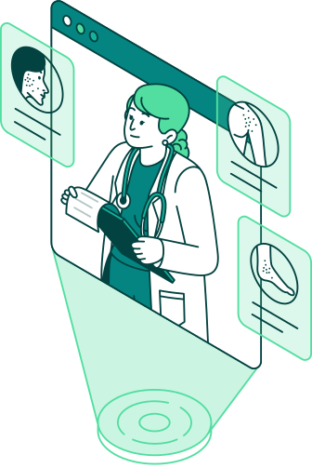
AGENDA
Challenge & User need statement
User Persona
Journey Map
Product Overview
Features
QnA

Slide 4
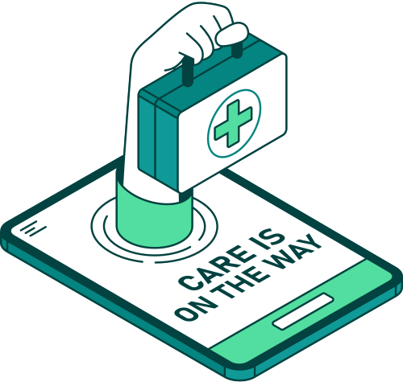


CHALLENGE STATEMENT
With rising rates of chronic illnesses, an aging population, and the growing role of caregivers
Reportedly 50% of patients do not take medications as prescribed
Between 2015 and 2050, the proportion of the world's population over 60 years will nearly double from 12% to 22%

Slide 5




USER NEED STATEMENT
Care Recipients
Care Givers
Notes:
Care Recipients: Individuals with chronic conditions or those requiring regular medication.
Caregivers: Family members, healthcare workers, or volunteers managing the care of loved ones or patients.

Slide 6
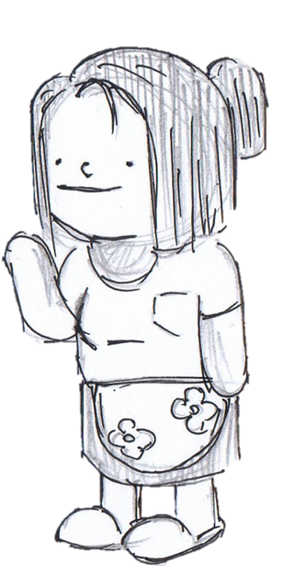
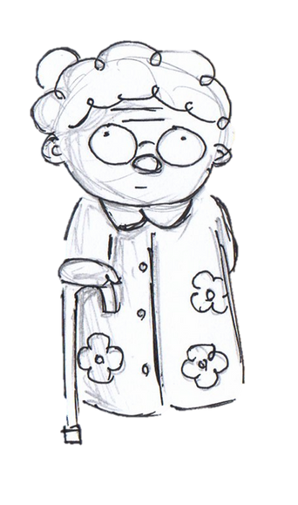

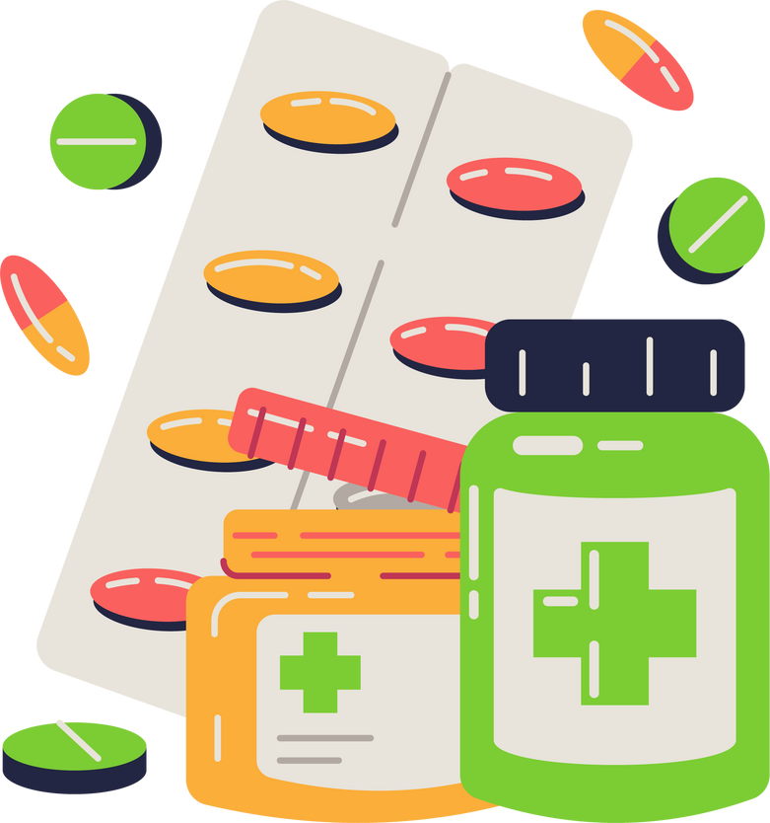
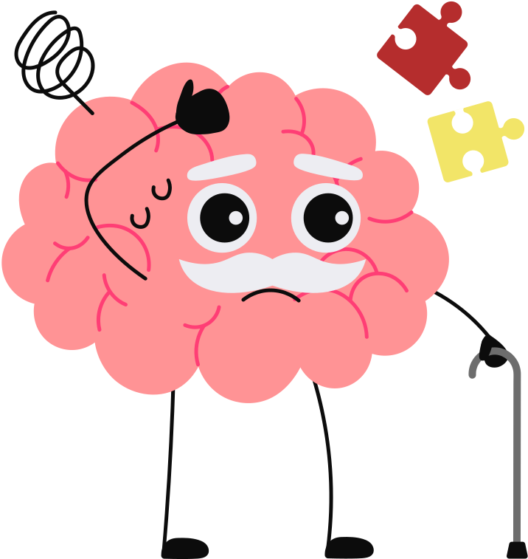

PERSONA
Take care of
her mum
Track Medication
Sarah
78 Years Old
Retired teacher
Emma
35 Years Old
Housewife
Memory Loss
Unable to physically
meet her mother
Notes:
Now that we've learned about the user requirements, let's meet Sarah—our main target audience.
Sarah is a 78-year-old retired teacher. She wants to keep track of her medications, but unfortunately, her memory loss and cognitive decline make it increasingly difficult. She sometimes forgets to take her medicine, which can be dangerous for her health.
On the other hand, we have Emma, her 35-year-old daughter. Emma is a housewife who deeply cares for her mother and wants to support her, but with her own busy life, she can’t always be physically present to help Sarah with her medications.

Slide 7
Scenario
Sarah, a 78-year-old retired teacher, struggles with remembering her daily medications due to memory loss. Her daughter, Emma, is unable to visit frequently but wants to ensure Sarah takes her medicine on time.
JOURNEY MAP
Stage
Action
Pain Points
Solutions
Awareness
Recognise difficulty in managing medications and frequently forgets to take medicine
Struggles to remember medications, leading to skipped doses
One application to manage all medications & provide reminders
Onboarding
Downloads CareSync, enters personal details and medications
Finds setting up multiple medications
confusing at first
Guided onboarding with visual prompts & caregiver-assisted help
Daily Use
Uses app to check daily medication schedule and logs mood
Occasionally forgets to log medicine intake
Interactive calendar and reminders ensure adherence to medication schedule
Medication Alert
Receives notification to consume medicine, marks it after consumption
May miss notifications due to being occupied
Multiple alert types (visual, sound, vibration) and caregiver reminders
Caregiver Support
Emma (caregiver) checks Sarah’s mood & medication discipline on caregiver’s dashboard
Emma worries about Sarah's adherence without frequent in-person visits
Monthly summaries help caregivers stay updated remotely
Refill & Consultation
Uses pharmacy locator to find nearby refills & schedules a doctor's appointment
Sarah may not realize when her medication is running low, leading to missed doses
Provides personal medication stock tracker with refill alerts to prevent stockouts
Notes:
Let’s walk through Sarah’s journey with CareSync and see how it improves her daily life.
Sarah often forgets to take her medications, leading to missed doses, but CareSync provides reminders to keep her on track.
When setting up the app, she found it overwhelming, but guided onboarding and caregiver-assisted setup made it easy.
With daily use, Sarah sometimes forgets to log her medication intake, but the interactive calendar and reminders ensure she stays consistent.
Emma worries about Sarah’s medication adherence, but monthly summaries and real-time updates keep her informed.
To prevent running out of medication, CareSync tracks Sarah’s stock and sends timely refill alerts, ensuring she’s always prepared.

Slide 8


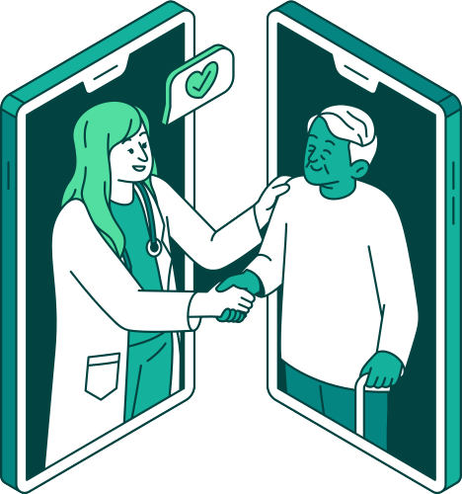


Innovation in Healthcare Solutions:
PRODUCT
Seamless and holistic Medication Health Management
Simplified medication tracking and management
Real time updates on medication availability
Proactive alerts and monthly summaries on care recipient mood patterns
Facilitate communication between caregivers and recipients
Notes:
Summary of the 4 key functionalities of the application
Medication tracking and management
Proactive alerts and monthly summaries on care recipient mood patterns
Real time updates on medication availability
Facilitate communication between caregivers and recipients

Slide 9
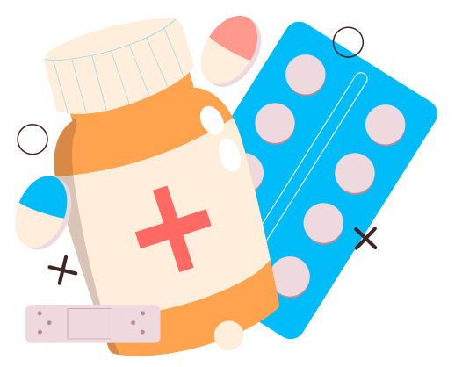
MEDICATION MANAGEMENT
Enable caregivers and care recipients to manage personal information and medications effortlessly
Track medication consumption schedules and consultation dates

Slide 10
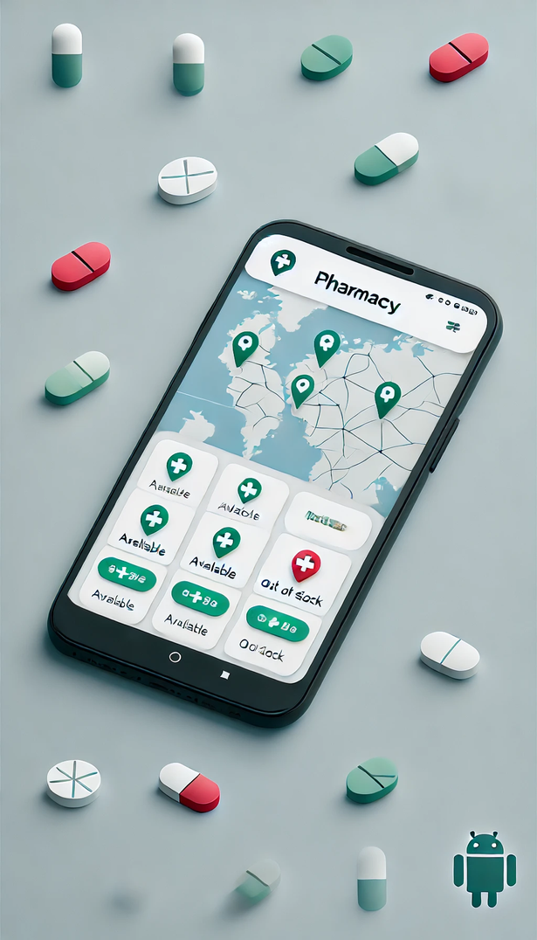



MAP FEATURE
Nearby Pharmacies and Clinics
Real-Time Stock Availability
Global Accessibility
Notes:
Find Nearby Pharmacies and Clinics
Users can easily discover the nearest clinics or pharmacies based on their current location or a specific search area.
Real-Time Stock Availability
Real-time information about the availability of specific medications using colour labels
Global Accessibility
Works across different countries, making it a reliable companion for users who travel frequently and may need to refill prescriptions in unfamiliar areas

Slide 11
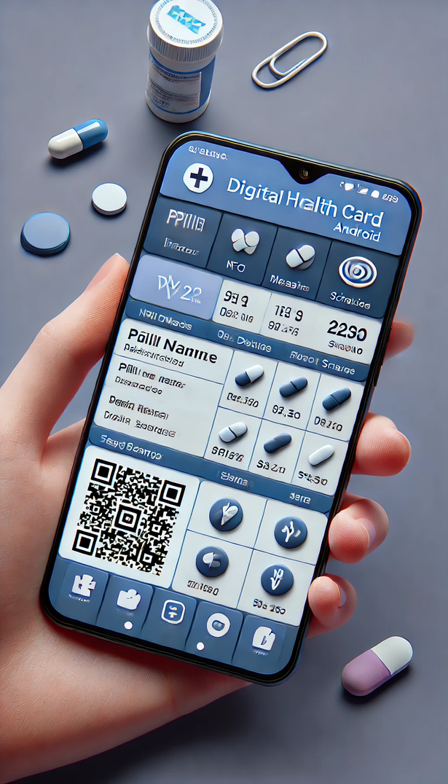
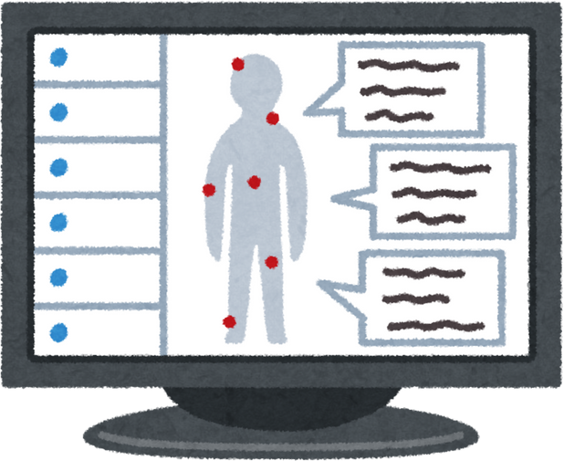

DIGITAL HEALTH CARD
Medication Overview Page
Social Sharing Options
Notes:
Medication Overview Page
Displays a detailed summary of the user's current medications, including the names of the pills, prescribed dosages, and schedules.
Social Sharing Options
Allows users to share their health card via messaging apps, QR Code or RFC, ensuring caregivers, family members and pharmacies can stay informed

Slide 12
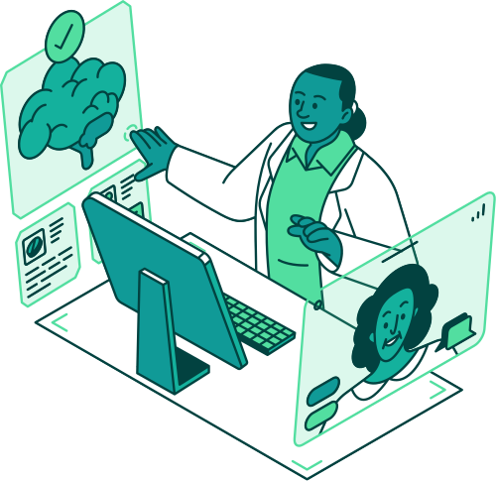
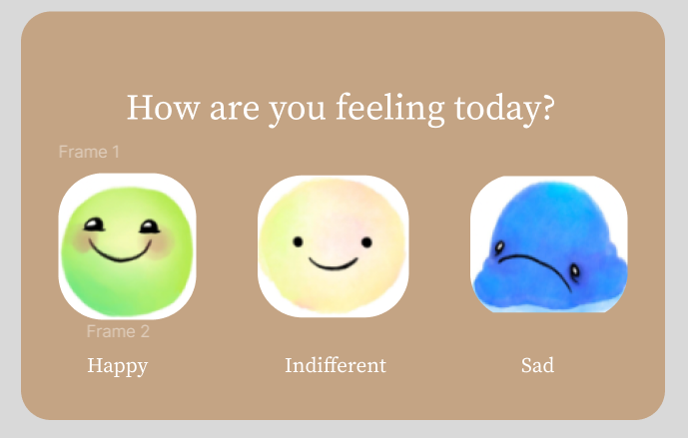
MOOD RATING TRACKER
Tracks how the user feels after consuming medication
Notes:
Fun and easy way to measure their mood everyday
Doctors can use this information to adjust dosage
Prompts the user after they take their medication
Especially useful for mental health patients

Slide 13
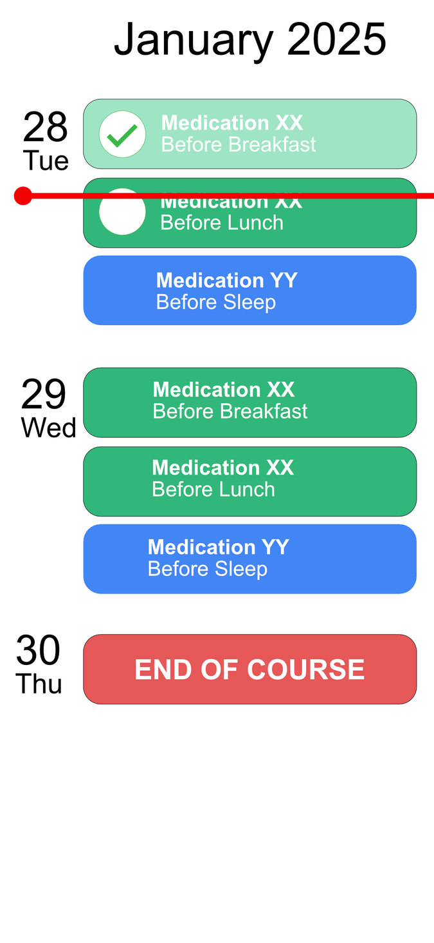
CALENDAR Feature
Generates feeding schedules based on dosage frequency
Tracks special instructions like "before meals" or "after meals."
Notes:
Centralizes medication schedules with clear visuals
Generates feeding schedules based on dosage frequency
Tracks special instructions like "before meals" or "after meals."

Slide 14
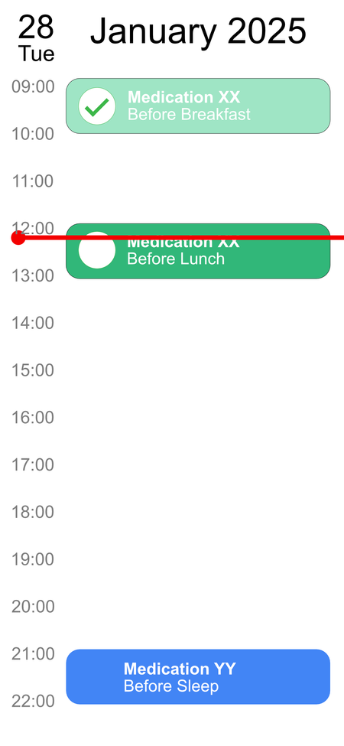
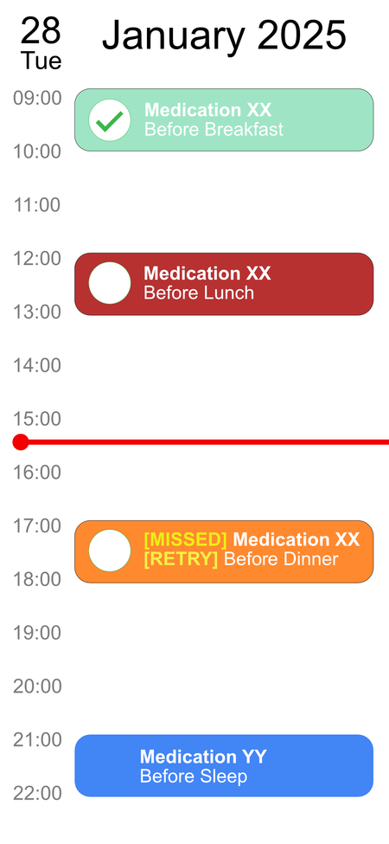

CALENDAR Feature
Displays compressed and detailed views for better navigation
Flags missed doses and postpones them to the next cycle

Slide 15
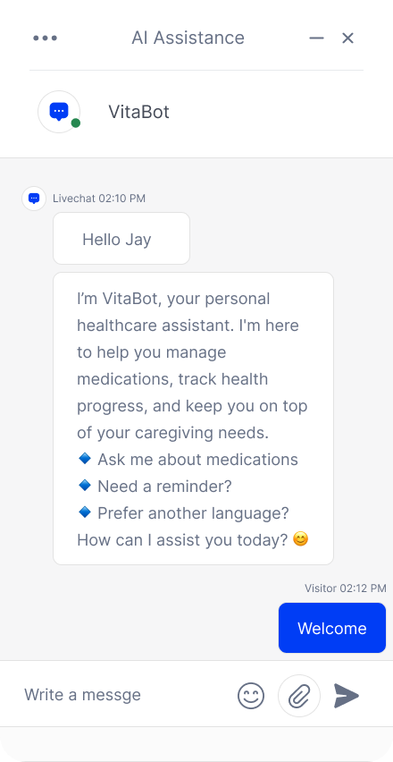


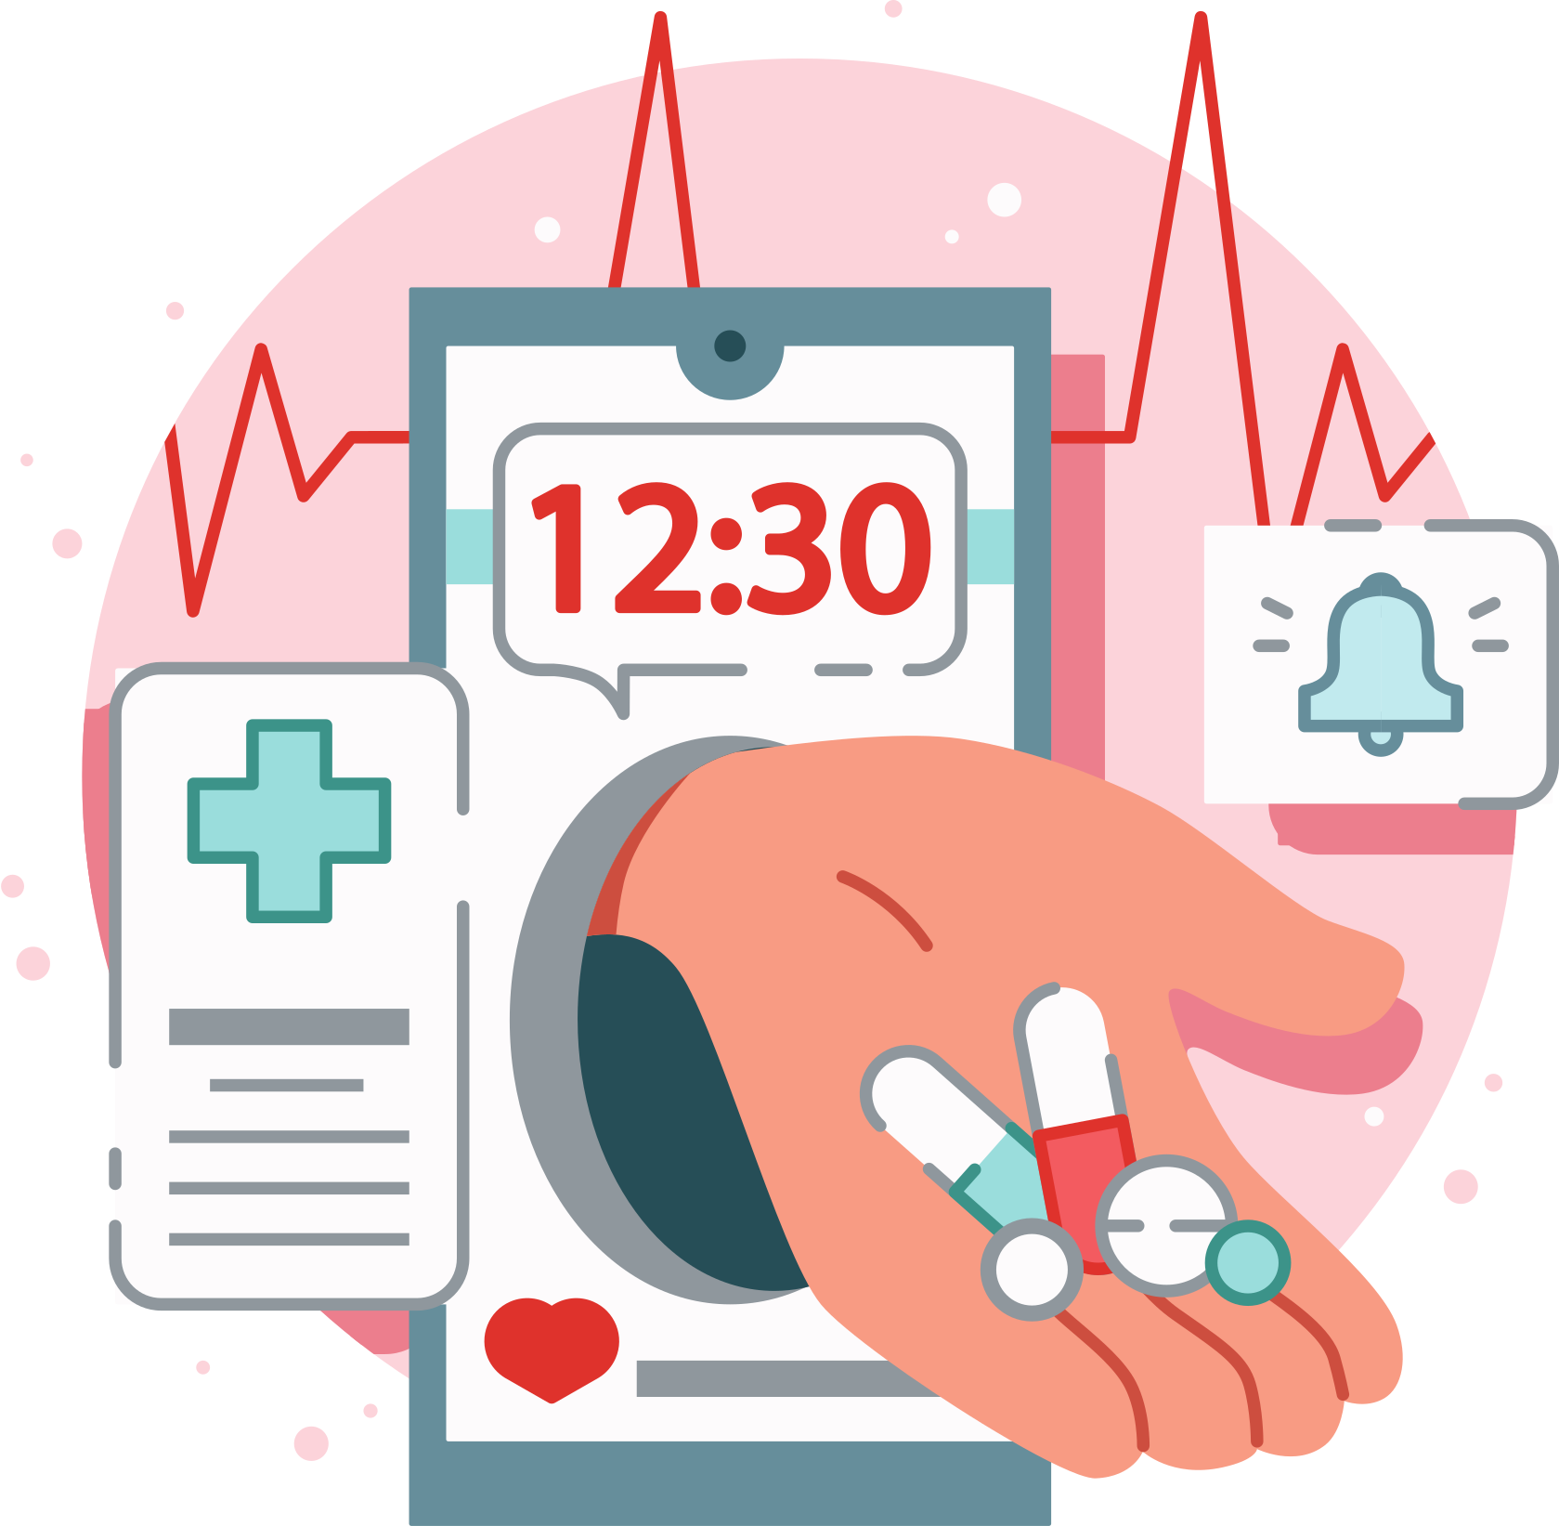
AI CHATBOT
Medication Query Support
Language Translation
Refill & Consultation Reminder
Notes:
Medication Query Support
Users can ask questions about medications through text or by uploading a photo, receiving instant AI-powered responses for better understanding and adherence.
Language Translation
Breaks language barriers by translating responses and resources into the user’s preferred language.
Refill & Consultation Reminders
Automates reminders for prescription refills and upcoming medical appointments, reducing missed doses or delays in care and keeping users proactively organized.

Slide 16
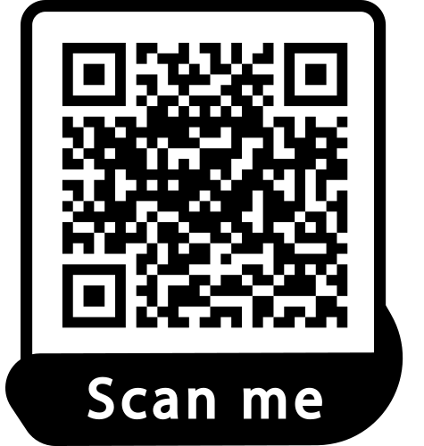




CAREGIVER ACCESS
Medication Management
Caregiver
Care
Recipient
Chat
Monitoring
Notes:
CareSync makes it seamless for caregivers to stay connected and informed. Care recipients can generate a QR code, which caregivers simply scan to link their accounts effortlessly. Once connected, caregivers can track medication schedules, chat with the care recipient, and monitor their adherence to medications in real time.

Slide 17
THANK YOU!
ANY QUESTIONS?

